Slide 1

STATISTICAL LEARNING — INDIVIDUAL PROJECT
Smartphone Usage
& Productivity
Behavioral Profiling and Predictive Modelling
Tushar Randhir Sinha
50,000 Observations × 13 Variables
Academic Year 2024/2025
R (tidyverse, randomForest, caret)

Slide 2
OVERVIEW
Contents
1
Introduction & Research Questions
2
Dataset Description
Context, objectives, and analytical framework
Variables, structure, and target outcomes
3
Exploratory Data Analysis
4
Unsupervised Analysis
Descriptive statistics and correlation analysis
PCA and K-Means clustering
5
Supervised Analysis
6
Results & Discussion
Regression and classification models
Model performance and key findings
7
Conclusions
Summary of findings and implications

Slide 3
1
INTRODUCTION
Research Questions
Smartphone usage has become one of the most pervasive behavioral patterns of modern life. Whether for social media, work-related tasks, or entertainment, people spend an increasing share of their waking hours on their devices. At the same time, concerns about the impact of this usage on cognitive performance, stress, and sleep are widely discussed in both popular media and academic research.
Research Question 1
Research Question 2
Can we identify distinct behavioral profiles among smartphone users based on their usage patterns?
Does smartphone usage behavior relate to work productivity and stress levels, and if so, how well can these outcomes be predicted?
Unsupervised Analysis
Supervised Analysis
Principal Component Analysis (PCA) and K-Means clustering to discover natural groupings in the data without predefined labels.
Regression and classification models to predict productivity scores and stress levels. Simple baseline compared against complex model to ensure model choice is justified by data.
Figure 1: Analytical framework combining unsupervised discovery and supervised prediction approaches.

Slide 4
2
DATASET
Description
50,000
13
0
Observations
Variables
Missing Values
Table 1: Variable Descriptions
Variable | Type | Description
User_ID | Identifier | Unique user code — excluded from analysis
Age | Numerical | Age (18–60)
Gender | Categorical | Male, Female, Other
Occupation | Categorical | Professional, Student, Business Owner, Freelancer
Device_Type | Categorical | Android or iOS
Daily_Phone_Hours | Numerical | Hours/day on phone
Social_Media_Hours | Numerical | Hours/day on social media
Work_Productivity_Score | TARGET | Self-reported productivity, 1–10
Sleep_Hours | Numerical | Average sleep hours/night
Stress_Level | TARGET | Self-reported stress, 1–10
App_Usage_Count | Numerical | Number of apps used/day
Caffeine_Intake_Cups | Numerical | Daily cups of coffee or tea
Weekend_Screen_Time_Hours | Numerical | Screen time on weekends

Slide 5
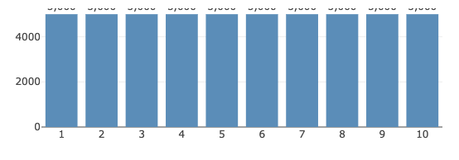


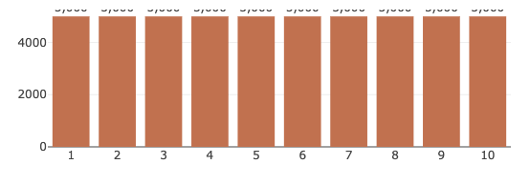

3.1
EXPLORATORY DATA ANALYSIS
Target Variable Distributions
Descriptive Statistics
Key Observation
Sample Size: 50,000 observations
Histograms of both target variables confirm approximately uniform distributions across the 1–10 range. Each integer value appears with roughly equal frequency (around 5,000 observations), which is a strong indicator that the data was synthetically generated with independently sampled outcomes.
Age Range: 18–60 years
Mean Age: ~39 years
Target Variables: Both distributed across full 1–10 range
Target Means: Close to 5.5, suggesting no heavy skew
Work Productivity Score
Stress Level
Figure 2: Histograms of Work Productivity Score (left) and Stress Level (right). Both variables are uniformly distributed across 1–10, each value appearing approximately 5,000 times.

Slide 6
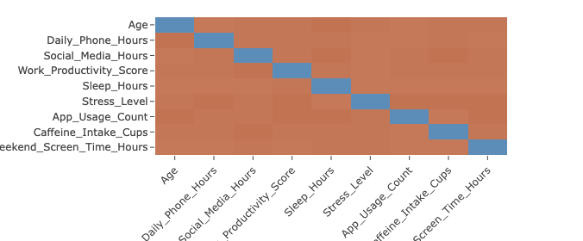
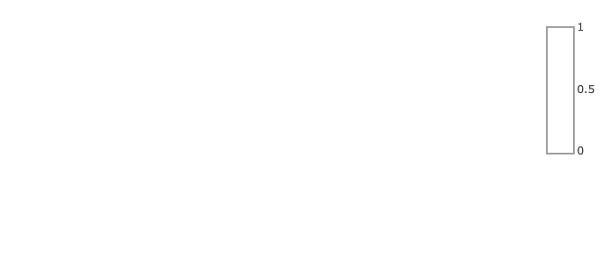

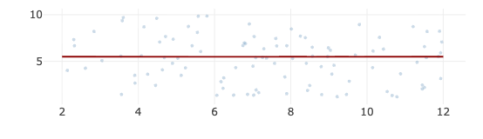
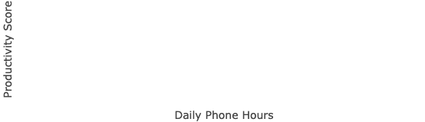

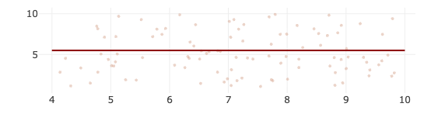

3.2
EXPLORATORY DATA ANALYSIS
Correlation Analysis
Correlation Matrix — Numerical Variables
Critical Finding
A correlation matrix was computed for all nine numerical variables. All pairwise correlations are extremely close to zero (maximum ≈ 0.01).
Implications
• No linear relationship exists between any pair of variables
• Predictors and targets are uncorrelated
• Sets realistic expectations for supervised model performance
• Confirms synthetic data generation with independent variables
Phone Hours vs Productivity (by Occupation)
Sleep Hours vs Stress (by Gender)
Figure 3: Correlation matrix and scatterplots showing all pairwise correlations are near zero. All group regression lines are essentially flat and parallel, visually confirming the absence of linear relationships.

Slide 7
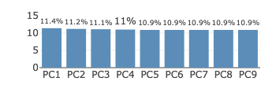
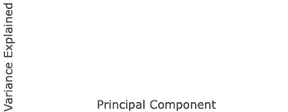

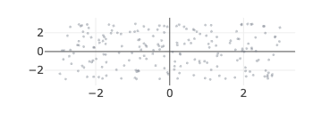
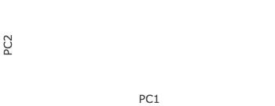
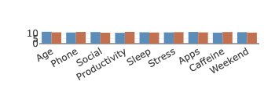
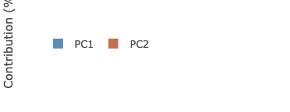
4.1
UNSUPERVISED ANALYSIS
Principal Component Analysis
Motivation
Methodology
The unsupervised analysis aims to discover whether natural groupings exist among users based on behavioral profiles, without imposing predefined labels. K-Means clustering was chosen for its interpretability and efficiency on large datasets.
PCA was applied to reduce dimensionality before clustering. All variables were standardized (mean = 0, sd = 1) beforehand — without this, variables with larger ranges would dominate components regardless of importance.
Scree Plot — Variance Explained
PCA Biplot
Variable Contributions
Key Finding
Each of the 9 components explains approximately 11% of variance (ranging from 11.4% to 10.9%), with no dominant component. This flat profile confirms the independent variable structure observed in the correlation matrix — a direct consequence of synthetic data generation.
Figure 4: Scree plot, PCA biplot, and variable contributions. The circular spread of observations with no directional structure is consistent with uncorrelated variables.

Slide 8
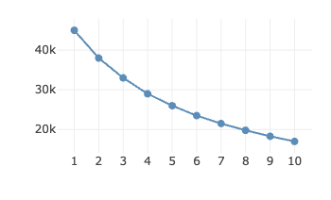
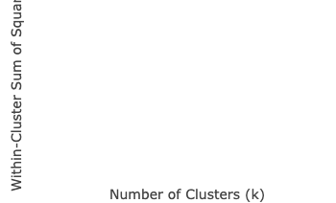

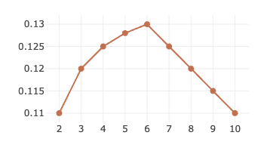
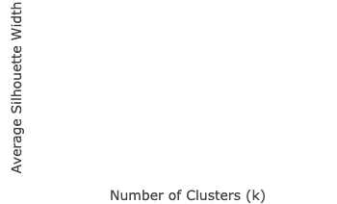

4.2
UNSUPERVISED ANALYSIS
K-Means Clustering
Elbow Method (WSS)
Silhouette Method
Cluster Selection
Two methods used on a 5,000-observation subsample:
• Elbow method: No sharp elbow visible — consistent with absence of natural cluster structure
• Silhouette method: Peaks at k=6, but values very low (≈0.13) across all k
k = 4 chosen as practical compromise
K-Means Clusters (k=4) in PC1-PC2 Space
Cluster Profiles (Z-Scored Means)
Cluster Characteristics
The heavy overlap between convex hulls reflects weak cluster separation indicated by low silhouette scores. Heatmap shows modest differences: Cluster 4 scores above average on productivity and below on caffeine; Cluster 3 shows elevated stress; Cluster 2 has higher mean age.
Figure 5: Elbow and silhouette plots for cluster selection, K-Means visualization, and cluster profile heatmap showing z-scored means across variables.

Slide 9
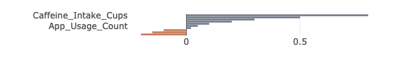


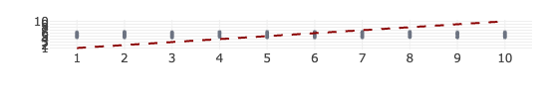
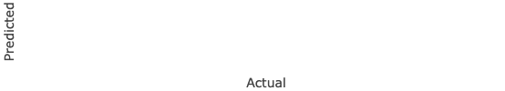
5.1
SUPERVISED ANALYSIS
Regression: Predicting Productivity
Data Preparation
Models
• Encoding: One-hot encoding with reference categories (Male, Freelancer, Android)
• Linear Regression: Interpretable baseline
• Random Forest: 300 trees, checks for non-linear patterns
• Train/Test Split: 70/30 using stratified sampling
• Metrics: RMSE and R² on test set
• Evaluation: All metrics on held-out test set only
Feature Importance — Random Forest
Actual vs Predicted — Productivity
Key Findings
Caffeine_Intake_Cups and Daily_Phone_Hours show slightly positive importance, but values are near zero for all variables — confirming that no predictor reliably improves predictions. Predictions cluster in a narrow band around 5–6 regardless of actual value, characteristic of a model that has learned the marginal mean but cannot predict individual outcomes.
Figure 6: Permutation feature importance and actual vs predicted scatterplot for Random Forest regression model.

Slide 10





5.2
SUPERVISED ANALYSIS
Classification: Predicting Stress
Task Definition
Models
Key Finding
Stress_Level binarized using median split at 6:
• Logistic Regression: Baseline model
other_gender and student show slightly positive values while several variables show negative importance — permuting them actually reduces error marginally, indicating no predictor provides reliable signal for classifying stress.
High ≥ 6
• Random Forest: Complex alternative (300 trees)
Low < 6
• Evaluation: Accuracy and confusion matrix
Produces balanced classes.
Feature Importance — Random Forest
Confusion Matrix — Random Forest
Classification Performance
Classification accuracy for both models was close to 50%, consistent with random guessing on a balanced binary outcome. The near-identical performance of simple baseline and complex Random Forest rules out the possibility that the linear model was too simple.
Figure 7: Permutation feature importance and confusion matrix for Random Forest classification model.

Slide 11
6
RESULTS & DISCUSSION
Model Performance Summary
Table 2: Model Performance on Test Set
Model | Task | RMSE | R² | Accuracy
Linear Regression | Regression (Productivity) | 2.87 | 0.001 | —
Random Forest | Regression (Productivity) | 2.86 | 0.002 | —
Logistic Regression | Classification (Stress) | — | — | 50.0%
Random Forest | Classification (Stress) | — | — | 50.1%
Regression Results
Classification Results
Both regression models produced R² values close to zero and RMSE values near the standard deviation of the target (≈2.87), confirming that the models capture essentially no variance in productivity.
Classification accuracy for both models was close to 50%, consistent with random guessing on a balanced binary outcome.
The near-identical performance of simple baseline and complex Random Forest model is an important diagnostic: it rules out the possibility that the linear model was too simple to capture genuine non-linear patterns.
The actual vs predicted plot illustrates this visually: predictions converge to the global mean rather than tracking individual values.
Critical Insight
The absence of predictive power is a property of the data, not a modelling failure. Feature importance plots show values close to zero or slightly negative for most variables, meaning that permuting predictors does not substantially change model error — further evidence that no variable carries predictive signal.
Figure 8: Summary table and discussion of model performance across all four models, demonstrating the data-driven nature of poor predictive performance.

Slide 12
7
CONCLUSIONS
Key Findings & Implications
Most Important Finding
The near-zero correlation structure confirmed across multiple analyses: histogram distributions, correlation matrix, scree plot, and supervised model results all point to the same conclusion — variables in this dataset were generated independently of one another. This makes meaningful supervised prediction impossible regardless of model complexity.
Analytical Contribution
Unsupervised Insights
Future Work
Reporting this honestly is itself an analytical contribution. Adding more complex models would not have changed the conclusion. The deliberate choice to compare a simple baseline with a powerful model in each supervised task confirmed that poor performance is a data property, not a modelling failure.
The unsupervised analysis identified four behavioral clusters with modest differences in mean profiles. The cluster composition analysis showed that these groupings are not aligned with sociodemographic variables, suggesting they reflect combinations of behavioral variables rather than demographic segments.
Future work on a dataset with genuine variable relationships would allow the full potential of these methods to be demonstrated and deliver actionable insights about the behavioral determinants of productivity and stress.
Methods Applied
Dataset: 50,000 observations × 13 variables
EDA • PCA • K-Means Clustering • Linear Regression • Random Forest • Logistic Regression
Software: R (tidyverse, randomForest, caret, factoextra)

